Slide 1
AIRLINE RESERVATION SYSTEM
DEPARTMENT OF MCA, MES COLLEGE OF ENGINEERING, KUTTIPPURAM
25 OCTOBER 2023
Prepared by
Rahana hameed(MES22MCA-2042)

Slide 2
Guided by MS. PRIYA J D
ASSISTANT PROFESSOR
MASTER OF COMPUTER APPLICATION
MES COLLEGE OF ENGINEERING, KUTTIPPURAM

Slide 3
Introduction
Modules
Project Plan
Product Backlogs
Sprint
Data Flow Diagram
CONTENTS

Slide 4
Introduction The world is evolving with technology, and the demand for seamless travel experiences is increasing. The "Airline Reservation System" project aims to revolutionize the way travelers book flights and airlines manage their operations. The objective of the project is to design and implement a secure and user-friendly platform that allows travelers to easily book flights, access detailed information, and manage their reservations. This project caters to the needs of both travelers and airline administrators, offering a comprehensive solution to enhance efficiency and reliability in the booking process.

Slide 5
MODULES
Admin
2. User
Login
Add More Flights
Update Flight Details
View Reservation
Register
Login
Search Flights
Flight Booking
View Flight Information
Manage Reservation

Slide 6
DEVELOPMENT ENVIRONMENT
SOFTWARE SPECIFICATION
Operating System
Frond End
Coding language
Framework
Backend
IDE
Browser
: Windows 7 or above
: HTML,CSS
:Python
:Django
:MySQL
: Pycharm
:Internet Explorer / Chrome / FireFox
HARDWARE SPECIFICATION
Processor
Hard Disk
RAM
: Intel Pentium IV or above
:80GB
:4GB or Above

Slide 7
PROJECT PLAN
ID | TASK NAME | START DATE | END DATE | PROJECT HOURS | STATUS
1 | Sprint 1 | 15/09/2023 | 12/10/2023 | 13 | Planned
2 | Sprint 2 | 13/10/2023 | 03/11/2023 | 14 | Planned
3 | Sprint 3 | 08/11/2023 | 30/11/2023 | 14 | Planned

Slide 8
PRODUCT BACKLOG
ID | NAME | PRIORITY | SIZE (Hours) | SPRINT | STATUS
1 | Registration | Medium | 8 | 1 | Planned
2 | Login | Medium | 4 |  | Planned
3 | Table Design | High | 10 | 2 | Planned
4 | Coding | High | 9 |  | Planned
5 | Testing Data | Medium | 4 | 3 | Planned
6 | Output Generation | High | 6 |  | Planned

Slide 9
SPRINT
SPRINT 1
Backlog Item | Status and Completion date | Original Estimate in hours | Day 1 15/09 | Day 2 20/09 | Day 3 21/09 | Day 4 28/09 | Day 5 29/09 | Day 6 04/10 | Day 7 05/10 | Day 8 06/10 | Day 9 11/10 | Day 10 12/10
Form Design | 15/09/2023 | 2 | 2 | 0 | 0 | 0 | 0 | 0 | 0 | 0 | 0 | 0
Table Design | 28/09/2023 | 3 | 0 | 1 | 1 | 1 | 0 | 0 | 0 | 0 | 0 | 0
Coding | 06/10/2023 | 6 | 0 | 0 | 0 | 0 | 2 | 1 | 1 | 2 | 0 | 0
Testing & Validation | 12/10/2023 | 2 | 0 | 0 | 0 | 0 | 0 | 0 | 0 | 0 | 1 | 1
Total |  | 13 | 2 | 1 | 1 | 1 | 2 | 1 | 1 | 2 | 1 | 1

Slide 10
SPRINT 2
Backlog Item | Status and Completion date | Original Estimate in hours | Day 1 13/10 | Day 2 18/10 | Day 3 19/10 | Day 4 20/10 | Day 5 25/10 | Day 6 26/10 | Day 7 27/10 | Day 8 01/11 | Day 9 02/11 | Day 10 03/11
Form Design | 13/10/2023 | 2 | 2 | 0 | 0 | 0 | 0 | 0 | 0 | 0 | 0 | 0
Table Design | 18/10/2023 | 1 | 0 | 1 | 0 | 0 | 0 | 0 | 0 | 0 | 0 | 0
Coding | 01/11/2023 | 8 | 0 | 0 | 1 | 2 | 1 | 1 | 2 | 1 | 0 | 0
Testing & Validation | 03/11/2023 | 3 | 0 | 0 | 0 | 0 | 0 | 0 | 0 | 0 | 1 | 2
Total |  | 14 | 2 | 1 | 1 | 2 | 1 | 1 | 2 | 1 | 1 | 2

Slide 11
SPRINT 3
Backlog Item | Status and Completion date | Original Estimate in hours | Day 1 08/11 | Day 2 09/11 | Day 3 10/11 | Day 4 15/11 | Day 5 16/11 | Day 6 17/11 | Day 7 22/11 | Day 8 23/11 | Day 9 24/11 | Day 10 29/11 | Day 11 30/11
Coding | 22/11/2023 | 9 | 1 | 1 | 2 | 1 | 1 | 2 | 1 | 0 | 0 | 0 | 0
Testing & Validation | 30/11/2023 | 5 | 0 | 0 | 0 | 0 | 0 | 0 | 0 | 1 | 2 | 1 | 1
Total |  | 14 | 1 | 1 | 2 | 1 | 1 | 2 | 1 | 1 | 2 | 1 | 1

Slide 12
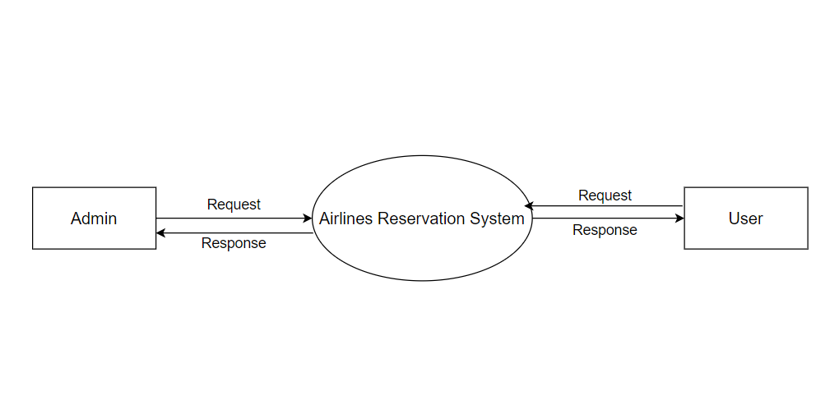
DATA FLOW DIAGRAM
LEVEL 0 :

Slide 13
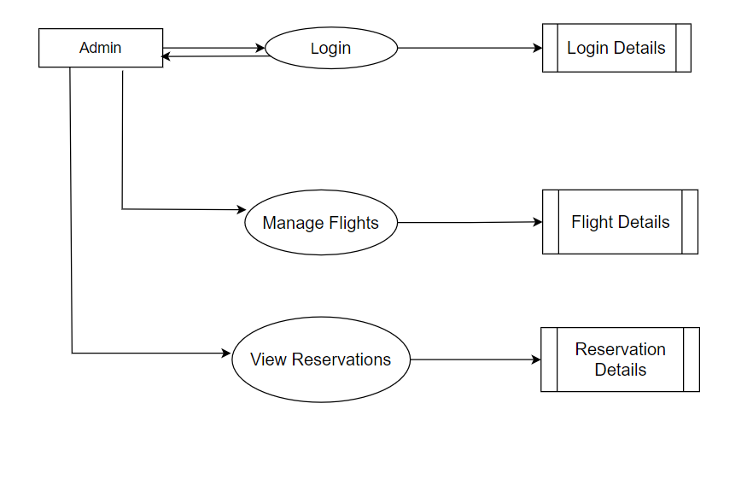
LEVEL 1:
Request
Request
Response
Request
Response
Request
Response

Slide 14
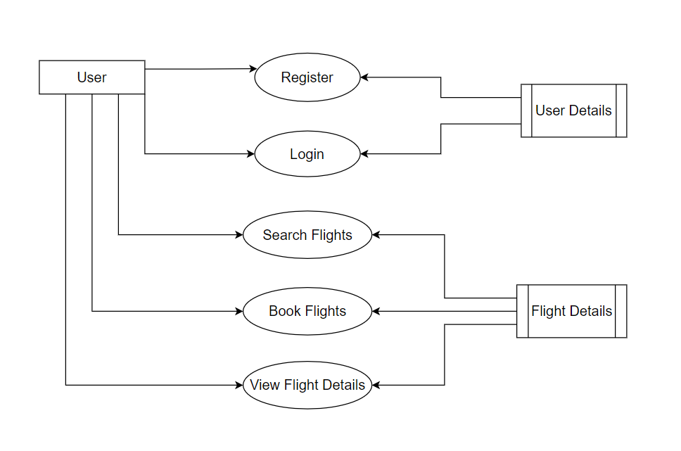
LEVEL 1 :
Request for registration
Request
Response
Response
Request for login
Request
Response
Response
Search for flights
Request
Response
Response
Request for flight booking
Request
Response
Response
Request
View Details
Response
Response

